Slide 1

Predicting Airbnb Housing Prices In London
Xiao Wan & Xiaozhou Yu & Xiaoyu Zhang
Team: T-X

Slide 2

Contents
Ý
Results & Discussion
Challenge
Baseline
Model
Data Exploration
Advanced
Model
Reference
Background

Slide 3

PART 1
Challenge
Challenge

Slide 4

Challenge
Our challenge is focused on making predictions that revolve around the housing price of Airbnb. Based on the Airbnb existing data, we will create a model to explore and predict the housing price of new listings in London.
Unlike traditional hotels, the housing price is set by house owner in Airbnb. In fact, there are many factors can impact the price of a new list such as location, room type, and published reviews. In this case, we need to take more consideration in feature selection for a better prediction.
London is the political, economic and cultural capital of Britain and one of the biggest markets in Airbnb. In June 2016, there are more than 42,000 records of listing in London. We need to deal with a large number of features of different types and handle missing value and outliers.

Slide 5
PART 2
Challenge
Background

Slide 6

Introduction to Airbnb
Airbnb is an online marketplace and homestay enabling people to rent a short-term home. The cost of such accommodation is set by the house owner.
Notes:
In this slide there is a background placeholder. Click to the small icon on the center of the slide and choose an image from computer. When add an image, you must sent it to back with Right Click on Image -> Send to Back -> Send to Back.

Slide 7



Business Implication
For Potential Tenants
For House Owners
For Airbnb

Slide 8
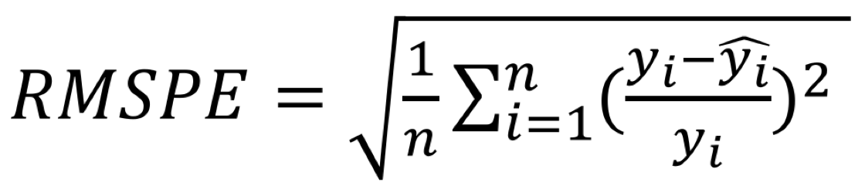
Methodology & Evaluation
Methodology
We use regression method to predict Airbnb housing prices. The problem of predicting housing prices can be considered a regression problem since the predictive values fall within a continuous range.
Evaluation
To avoid the influence of different price level, we use relative error instead of na absolute error. The results are evaluated on RMSPE-Root Mean Square Percentage Error.

Slide 9
PART 3
Challenge
Data Exploration

Slide 10
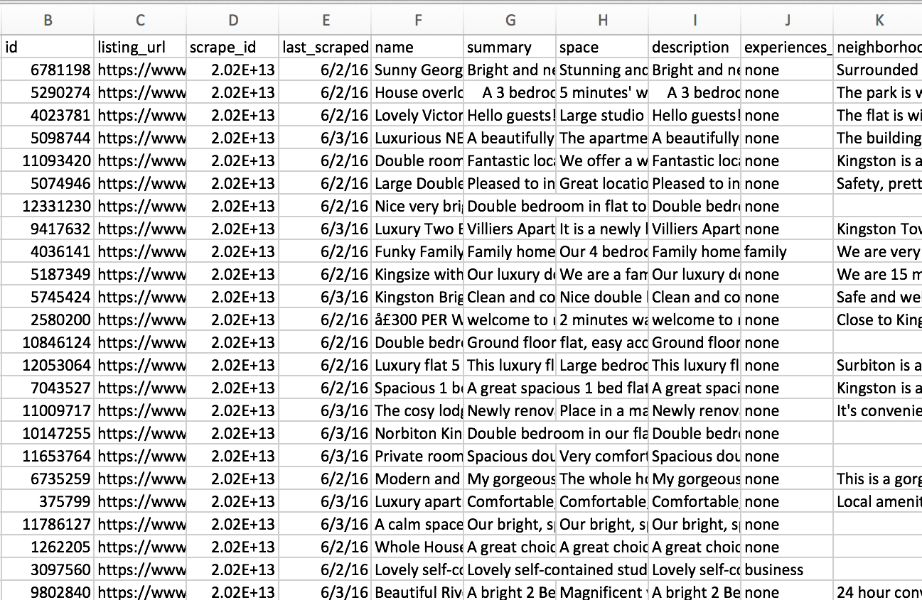
Data Description
Dataset obtained from Inside Airbnb (http://insideairbnb.com).
Independent, non-commercial data scraped from open Airbnb listings.
The original dataset contains 42,646 records and 95 variables.

Slide 11
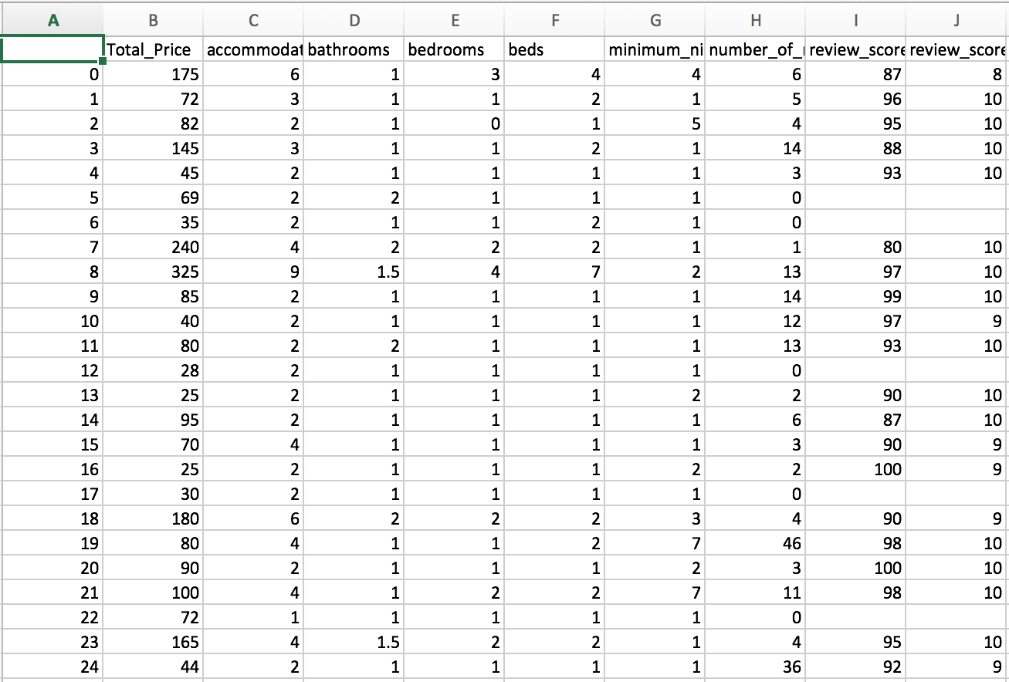
Data Cleaning
1
Manually Removal
Remove columns that are either irrelevant or null.
2
Format Conversion
Convert columns into desirable format. E.g., convert price to double, bedrooms to integer and host date to datatime.
3
Target Variable
Combine column price and cleaning fee into one column: total price. Use it as the target variable
4
Categorical Variables
Add dummy variables for categorical variables such as room type and experience offered.
5
Outlier & Missing Value
Remove records with unreasonable prices. Fill in null records with proper values.
Notes:
In this slide there is a background placeholder. Click to the small icon on the center of the slide and choose an image from computer. When add an image, you must sent it to back with Right Click on Image -> Send to Back -> Send to Back.

Slide 12
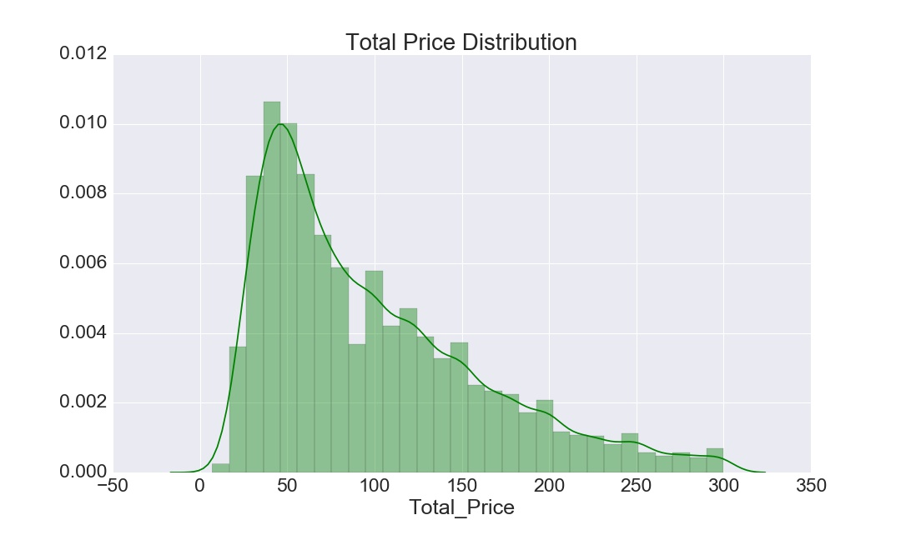
Exploratory Data Analysis
After data cleaning, the dataset contains 38,541 records and 72 variables.
The price ranges from 10 to 300, its distribution is positively skewed.
(a) Distribution of Actual Sample Prices

Slide 13
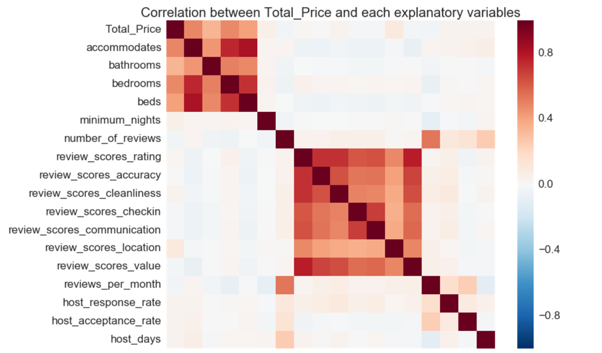
Exploratory Data Analysis
Then we obtained the correlation between price and all explanatory variables.
The most related features are neighborhood and room type, which would be used to build baseline model on next step.
(b) Correlation between Price and Explanatory Variables

Slide 14
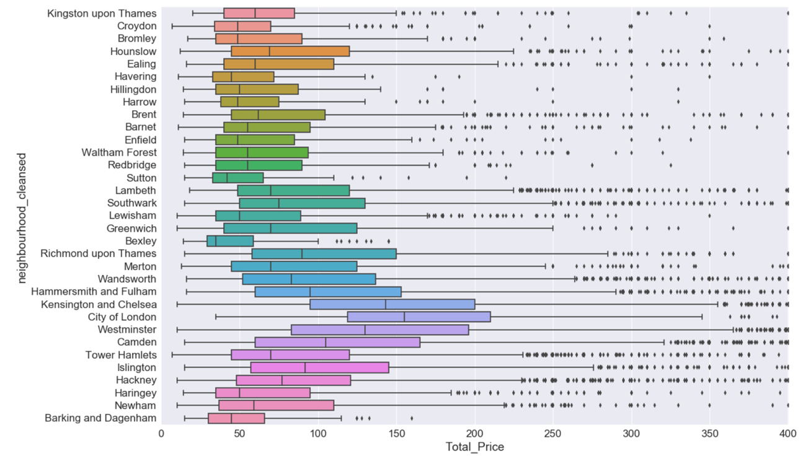
Exploratory Data Analysis
The distribution of price is quite different by neighborhood.
Costs rise as the houses locate nearer to the center of the city.
(c) Distribution of Price Per Neighbors

Slide 15
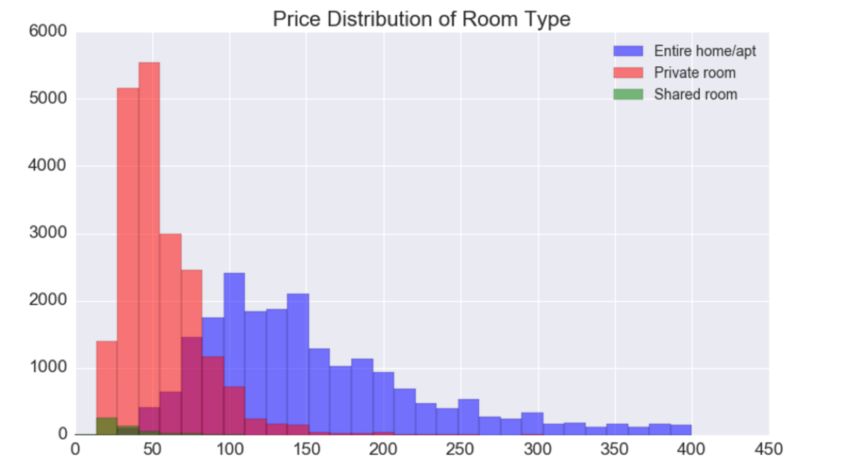
Exploratory Data Analysis
The distribution of price is significantly influenced by room type.
Rent for entire house can be much higher than private room.
The number of samples is in inverse proportion to price.
(d) Distribution of Price Per Room Type

Slide 16
PART 4
Challenge
Baseline Model

Slide 17
Baseline Model
Methodology
A simple model that predicts the housing prices based on two features - Room Type and Neighborhood.
Divide all training data into different groups
Calculate the average housing prices for each group.
Predict price of each house as the average housing price of the group it belongs
Results
A static model, houses in the same group will always get the same price prediction.
RMSPE: 46.8%.

Slide 18
PART 5
Challenge
Advanced Model

Slide 19

Model Introduction
Multiple Linear Regression
Lasso
Bagging
Random Forest
Gradient Boosting
Housing Price as target variable, all the
other features introduced in section 3 as predictors.
Build fully-developed decision trees on boostraped training data, averaging each individual prediction to improve the predictive accuracy and control over-fitting.
Use fully-developed decision trees as base learners. This time build trees sequentially: each tree is fitted on the residual given by the previous prediction.
Add L1 norm regularization to Multiple Linear Regression model
to reduce over-fitting.
Fits base learners on boostraped training data, averaging each individual predictions to reach a final prediction.

Slide 20
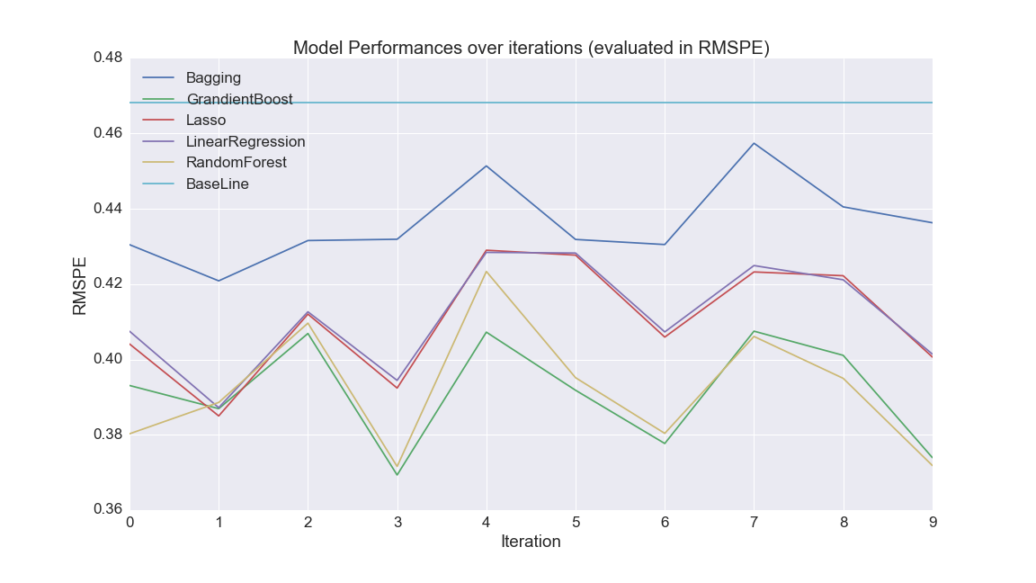
Model Evaluation and Selection
Each model's RMSPE on the training dataset through 10-fold cross-validation. In general, low RMSPE indicates better model performance. Gradient boosting (Green Line) gives the lowest RMSPE.

Slide 21
Parameter Tuning
maximum depth Maximum tree depth for base learners. A larger value indicates a more complicated tree. The ideal value is 10.
gamma Minimum loss reduction required to make a further partition on a leaf node of the tree. The ideal value is 0.3.
subsample & colsample Subsample ratio of the training instance and subsample ratio of columns when constructing each tree. Ideal values are 0.9 and 0.8 respectively.
reg alpha & reg lambda L1 and L2 regularization term on weights. Ideal values are 0.5 and 6 respectively.
learning rate & number of estimators Boosting learning rate and Number of boosted trees to fit. Use a small learning rate and a large number of estimators to construct a robust model

Slide 22
PART 6
Challenge
Results & Discussion

Slide 23
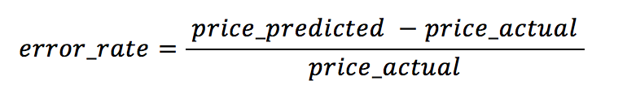
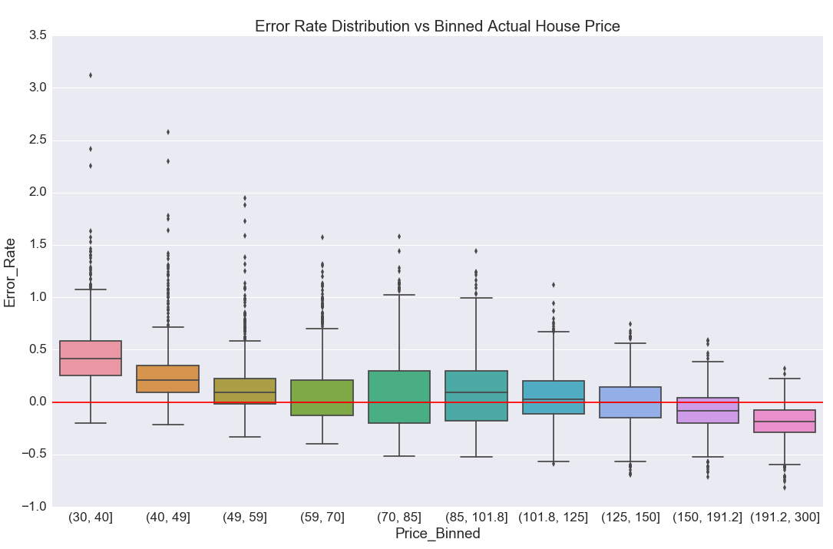
Error Analysis
Final Model – XGBoost
Best performance according to cross validation.
The RMSPE on testing data is 36.29%.
1
Error Distribution vs Actual Price
The actual price has been binned into 10 group.
2
Performance
Conservative. Good at middle price, over-predict at lower price, under-predict at higher price.
3
Analysis
Under-fitting. Through ANOVA and importance assessment of features based on information gain.
4
Reasons
Lack of potential key features
Irregularity of pricing exits in homestay marketplace
Error Analysis of XGBoost Model

Slide 24
Possible Improvement
1
MORE EXPLOROTARY VARIABLES
Improve the complexity of the model:
Amenities
(kitchen, parking plot, internet, TV, heating, etc.) Neighborhood environment
(crime rate, distance to downtown, grocery or restaurant, etc.)
CHANGE FUNCTIONS
2
Alter objective and evaluation functions used by XGBoost algorithms
NEW TECHNIQUES
3
Try techniques such as feature engineering

Slide 25
PART 7
Challenge
Reference

Slide 26
Reference
1. Chen T, Guestrin C. Xgboost: A scalable tree boosting system[J]. arXiv preprint arXiv:1603.02754, 2016.
2. Ng A, Deisenroth M. Machine Learning for a London Housing Price Prediction Mobile Application[J]. 2015.
3. Brennan, Morgan (16 Sep 2011). "The Most Amazing And Absurd Places For Rent". Forbes. Retrieved 13 December 2012.
4. Introduction to Boosted Trees https://xgboost.readthedocs.io/en/latest/model.html
5. Complete Guide to Parameter Tuning in XGBoost https://www.analyticsvidhya.com/blog/2016/03/complete-guide-parameter-tuning-xgboost-with-codes-python/

Slide 27
THANK YOU

